Slide 1

Dr. Ritu Agarwal
Senior Consultant Obstetrics & Gynaecology
MBBS | M.D | DGO

Slide 2
MISSION
Aims to deliver the highest quality of care to patients with obstetrics & gynecological problems.​ This entails the application of the latest advances in the field , for diagnosis and treatment of patients, in atmosphere of compassion and respect .Thus aims to deliver highest quality of clinical expertise with a passion to serve.

Slide 3
Dr. Ritu Agarwal is a Gynaecologist, Obstetrician and Laparoscopic surgeon and infertility specialist.
She has completed her MBBS and MD in Obstetrics & Gynaecology from the Institute of Medical Sciences (IMS), Banaras Hindu University (BHU). Trained under renowned stalwarts in the field, she has extensive experience in managing high-risk obstetric cases and complex gynaecological conditions. With in-depth knowledge and expertise in her specialty, she brings nearly 28 years of clinical experience in Obstetrics and Gynaecology.

Slide 4
Compassionate Care. Extensive Experience. Personalised Treatment.
With over 28 years of experience in women’s healthcare, Dr. Ritu Agrawal combines extensive clinical expertise with a compassionate, individualised approach to care. She is committed to helping women make informed decisions about their reproductive, obstetric, and gynaecological health, while ensuring personalised treatment tailored to their unique needs.

Slide 5
About Dr. Ritu Agrawal
Renowned Obstetrician & Gynaecologist in Ghatkopar, Mumbai
Dr. Ritu Agrawal is a renowned Obstetrician and Gynaecologist with over 28 years of clinical experience, dedicated to providing comprehensive, compassionate, and personalised care to women at every stage of life.
With extensive experience in obstetrics, Dr. Agrawal has a special interest in high-risk pregnancies and complex deliveries, while also providing expert care for routine pregnancy and childbirth.
She is highly experienced in the conservative and surgical management of a wide range of gynaecological conditions.
Her areas of expertise include fertility-enhancing procedures and advanced minimally invasive techniques such as laparoscopic hysterectomy, with a strong focus on patient safety and effective clinical outcomes.
Dr. Agrawal is skilled in open, vaginal, and laparoscopic gynaecological surgeries. She believes in an individualised approach to treatment, taking the time to understand each patient's needs and providing care tailored to their specific condition and circumstances.

Slide 6
Areas of Expertise
Obstetric Care
High-Risk Pregnancy Management
Antenatal & Postnatal Care
Normal & Cesarean Deliveries
Complex & Routine Obstetric Care
Family Planning & Contraceptive Counseling
Gynaecological Care
Diagnosis & Management of Gynaecological Problems and Disorders
PCOS / PCOD Management
Menstrual Disorders
Menopause & Hormonal Care
Adolescent Gynaecology
Treatment of Fibroids & Ovarian Cysts
Preventive Women’s Health Check-ups
Fertility & Reproductive Health
  Infertility Evaluation & Treatment
  Fertility-Enhancing Procedures & Surgeries
Gynaecological Surgery
  Minimally Invasive Gynaecological Procedures
  Laparoscopic Hysterectomy
  Advanced Laparoscopic Gynaecological Surgery
  Open Gynaecological Surgery
  Vaginal Surgery

Slide 7
Zynova Hospitals Pvt. Ltd.,
LBS Marg, Ghatkopar West,
Mumbai – 400086, Maharashtra
Timing : – 06:00 to 07:00 pm every day.
Sapna Health Care Centre.LBS MARG , GHATKOPAR WEST
Timing : – 07:00 to 08:00 pm every day.
Disha Hospital,
Andheri-Ghatkopar Link Road, Ghatkopar (w), Mumbai, India, Maharashtra 400086
Pancholi Hospital
90 Feet Rd, Sudarshan Society, Garodia Nagar, Ghatkopar East, Mumbai, Maharashtra 400077
Jeevan Jyot Hospital
Jeevan Jyoti Apartment, Station Road, Ghatkopar West, Landmark Opposite Railway Station,Mumbai, Maharashtra, 400086

Slide 8

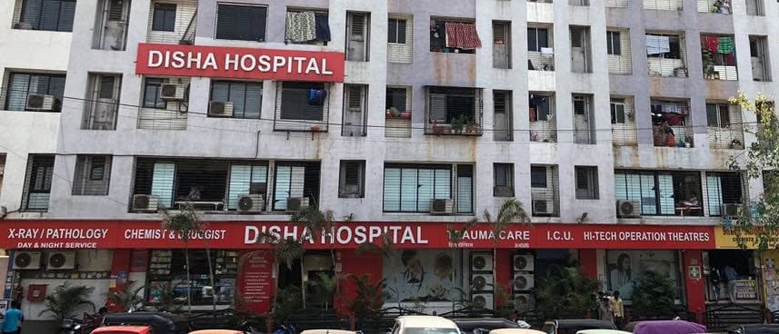

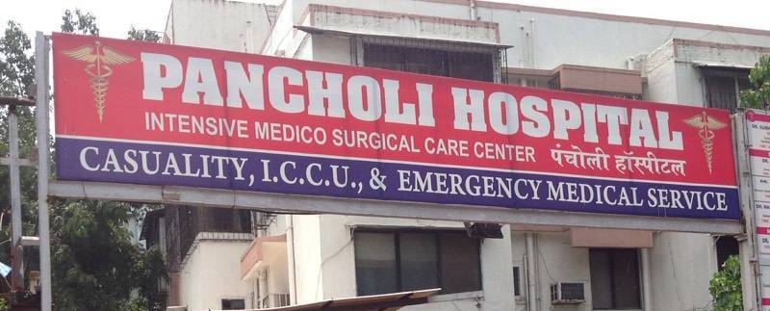
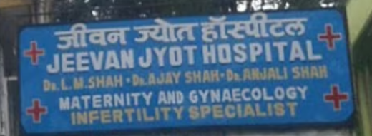

Slide 9
Laparoscopy & Keyhole Surgery
Laparoscopy, also known as keyhole surgery, is an important part of modern gynaecological care. It offers significant advantages in the management of infertility and a wide range of gynaecological conditions, including reduced hospital stay, less postoperative discomfort, and faster recovery.
For the surgeon, laparoscopic procedures provide enhanced magnification and precision, along with reduced blood loss in many procedures. Fertility-enhancing procedures, ovarian surgeries, and hysterectomies can be performed using advanced laparoscopic techniques when clinically appropriate.
With access to a well-equipped operating theatre and a skilled, experienced surgical team, Dr. Ritu Agrawal focuses on delivering safe, precise, and effective minimally invasive gynaecological care with the aim of achieving excellent clinical outcomes.

Slide 10

ANTENATAL SCREENING AND COUSELLING
Regular Antenatal care
Antenatal Yoga
Painless deliveries
Regular antenatal education session for patients .
Prenatal evaluation,screening for abnormalities and relevant counselling and advice
Is given,helping to detect problems at a nascent stage .
We support you throughout your pregnancy ,we provide best possible care during all 3 trimesters with complete ultrasound scans, lab tests and consultations.
Our team comprises best doctors who focus on normal pregnancy and delivary , thus we are identified as a Normal Delivery Hospital .
You and your little angel are in the safest hands at our centre and its one of the best maternity hospital in Mumbai.

Slide 11
Hospital Facilities & Services
Well-Equipped Labour & Delivery Rooms for safe and comfortable childbirth
Ultra-Modern Operation Theatre equipped with advanced surgical technology
Level III NICU & ICU for specialised critical care when required
Ventilator-Enabled Ambulance Services for emergency medical transportation
Trained & Experienced Nursing and Medical Staff providing attentive care
24×7 Pharmacy, Ultrasound, Laboratory & X-Ray Services for round-the-clock support
Blood Storage Facility for timely access to blood products when required
Painless Delivery Options with epidural analgesia, where clinically appropriate
Experienced Medical Specialists for comprehensive maternity and gynaecological care
Flexible Maternity Packages designed to meet different patient needs

Slide 12
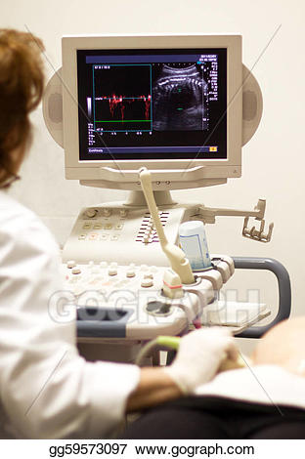
Ultrasound in Obstetrics & Gynaecology
Ultrasound is an essential diagnostic tool in modern Obstetrics and Gynaecology, offering valuable insights for accurate assessment and monitoring. It is routinely used for antenatal monitoring, pregnancy assessment, and infertility evaluation.
With access to advanced ultrasound technology and experienced clinical expertise, patients can benefit from accurate evaluation of a wide range of obstetric and gynaecological conditions. Ultrasound also supports routine and interventional procedures, helping enable precise diagnosis and appropriate treatment planning.

Slide 13
Cancer Screening
Early detection of cancer can significantly improve treatment outcomes, particularly when precancerous changes or cancer are identified at an early stage. Regular screening plays an important role in the prevention and early detection of common gynaecological and breast cancers.
Cancer screening and evaluation may include Pap smears, colposcopy, mammography, and other appropriate investigations, based on the patient’s age, symptoms, risk factors, and clinical history. Screening and treatment are planned in accordance with established international guidelines and evidence-based medical practices.

Slide 14
Infertility Treatment
Couples experiencing infertility receive comprehensive evaluation, appropriate investigations, and personalised treatment based on their individual needs. The approach focuses on identifying the underlying cause and offering the most suitable fertility-enhancing options.
Laparoscopic and hysteroscopic procedures for fertility enhancement are routinely performed when clinically indicated. Our operating theatres are equipped with advanced surgical technology, including Harmonic Scalpel, high-definition cameras, and specialised laparoscopic instruments, supporting precise and minimally invasive procedures.
Patients have access to a multidisciplinary team of fertility and assisted reproductive medicine specialists, who provide evidence-based care across a range of treatment options, including IUI and IVF, as well as advanced hysteroscopic and laparoscopic surgeries where required.
The fertility care team includes experienced embryologists, counsellors, dieticians, and physiotherapists, providing coordinated support throughout the treatment journey.

Slide 15
Adolescent Gynaecology
Dr. Ritu Agrawal is committed to promoting healthy development and reproductive health awareness among adolescent girls. She has conducted educational sessions and delivered lectures in schools on menstrual hygiene, puberty, and adolescent health.
Her adolescent gynaecology services include:
Menstrual health and hygiene counselling
Education on puberty and reproductive health
Age-appropriate sex education and awareness
Counselling for menstrual and hormonal concerns
Guidance on maintaining healthy lifestyle and personal hygiene

Slide 16
Preconception & Sexual Health Counselling
When couples begin planning a family, preconception and sexual health counselling can help address concerns related to reproductive health and intimacy. Our team provides confidential, sensitive, and personalised guidance to couples on sexual health, fertility, and related concerns, helping them prepare for a healthy pregnancy.

Slide 17

Menopausal Clinic
The Menopausal Clinic provides comprehensive and personalised care for women during and after menopause, with a focus on managing symptoms, maintaining long-term health, and improving overall well-being.
Services include:
Menopause Counselling & Regular Care — guidance for managing physical and emotional changes associated with menopause
Osteoporosis Prevention & Management — assessment and guidance to support bone health
Cancer Screening — age- and risk-appropriate screening and preventive care
Yoga & Exercise Guidance — recommendations to support fitness, strength, flexibility, and overall well-being
Personalised Diet Plans — nutritional guidance tailored to individual health needs and menopausal concerns

Slide 18
Our Services
We provide a comprehensive range of preventive, medical, and surgical gynaecological services, including:
Hysterectomy — including laparoscopic and other appropriate surgical approaches
Pap Smear & Colposcopy — for cervical health assessment and screening
Laparoscopy (Keyhole Surgery) — for the diagnosis and treatment of various gynaecological conditions
Contraception & Family Planning — personalised counselling and contraceptive options
HPV Vaccination — vaccination and guidance for prevention of HPV-related diseases

Slide 19
We Treat ---
We provide comprehensive diagnosis and treatment for a wide range of gynaecological conditions, including:
Endometriosis
Uterine Fibroids
Urinary Incontinence
Gynaecological Infections — including UTIs and Pelvic Inflammatory Disease (PID)
Pelvic Organ Prolapse
Abnormal Uterine Bleeding
Sexually Transmitted Infections (STIs)
Polycystic Ovary Syndrome (PCOS)
Ovarian Masses and Cysts
Abnormal or Irregular Menstrual Periods
Premenstrual Syndrome (PMS)

Slide 20

Diet during pregnancy

Slide 21


Slide 22


Slide 26


Slide 27


Slide 28
